Slide 1
CRM Console Application
A Macro Project by
Devesh Koshta & Mayank Sharma
Mentor: Dr. Suchitra Agrawal
MITS, Gwalior (M.P.)

Slide 2
Introduction
CRM Systems Help Manage Customer Relationships And Data.
Most Existing CRMs Are Cloud-based, Costly, And Complex.
This Project Presents A Lightweight, Offline CRM Built Using C++.
It Performs Crud Operations Using File Handling And Modular Design.

Slide 3
Motivation & Problem Statement
Students Often Lack Hands-on Exposure To Real CRM Logic.
Existing CRMs Are Too Heavy Or Expensive For Small Projects.
Need For A Simple, Offline Model To Demonstrate CRM Concepts.

Slide 4
Objectives
Develop A Console-based CRM With CRUD Features.
Implement File Handling For Data Persistence.
Demonstrate OOP Concepts (Classes, Inheritance, Encapsulation).
Ensure Modularity And Reusability In Code.
Provide Offline Functionality And Easy Extensibility.

Slide 5
System Overview
Three Layers: User Interface, Logic, Data Storage.
Console-based Menu System For Easy Interaction.
File-handling Ensures Local Storage Without Database.
Diagram: Simplified Architecture (User → Logic → File).

Slide 6
System Design & Architecture
Data Flow: User Inputs → Processed Via CRM manager → Saved In File.
Classes: Client, CRM manager, Filehandler.
Diagram: DFD (Add, View, Update, Delete → Clients.Txt).

Slide 7
Implementation
Language: Python | IDE: MongoDB & Rechart | Storage: Text Files.
Menu-driven Control For All Operations.
Efficient File Reading/Writing Ensures Quick Performance.
Flow: Menu → Function → File → Output.

Slide 8
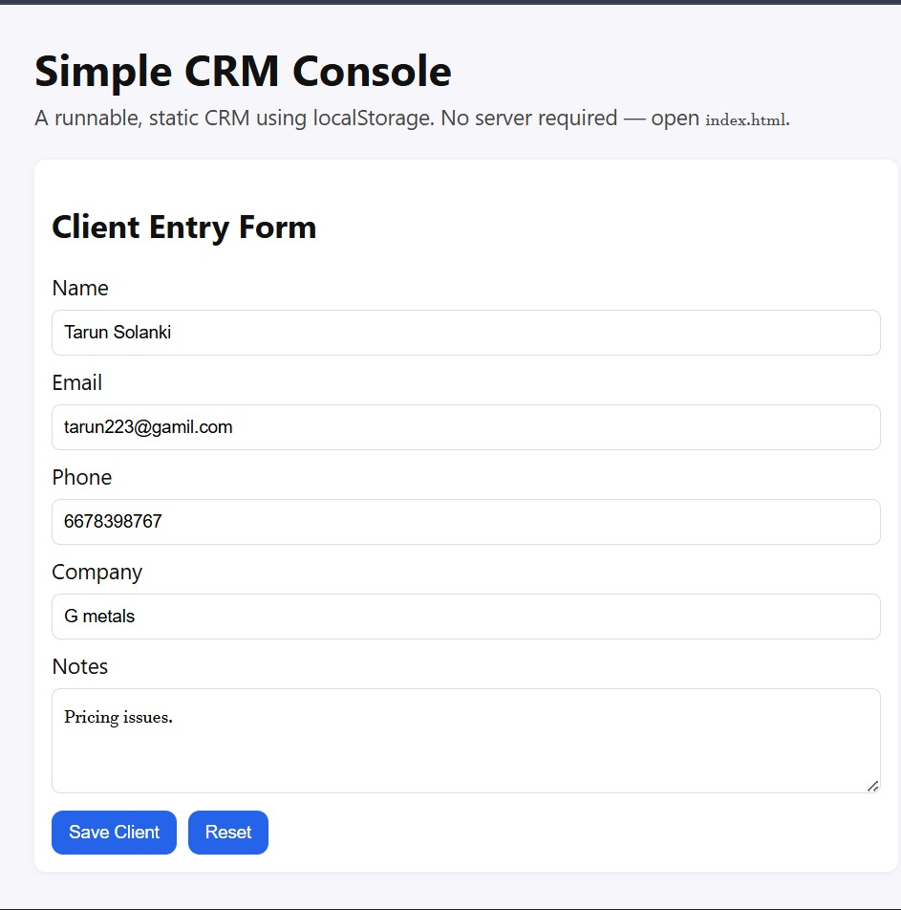
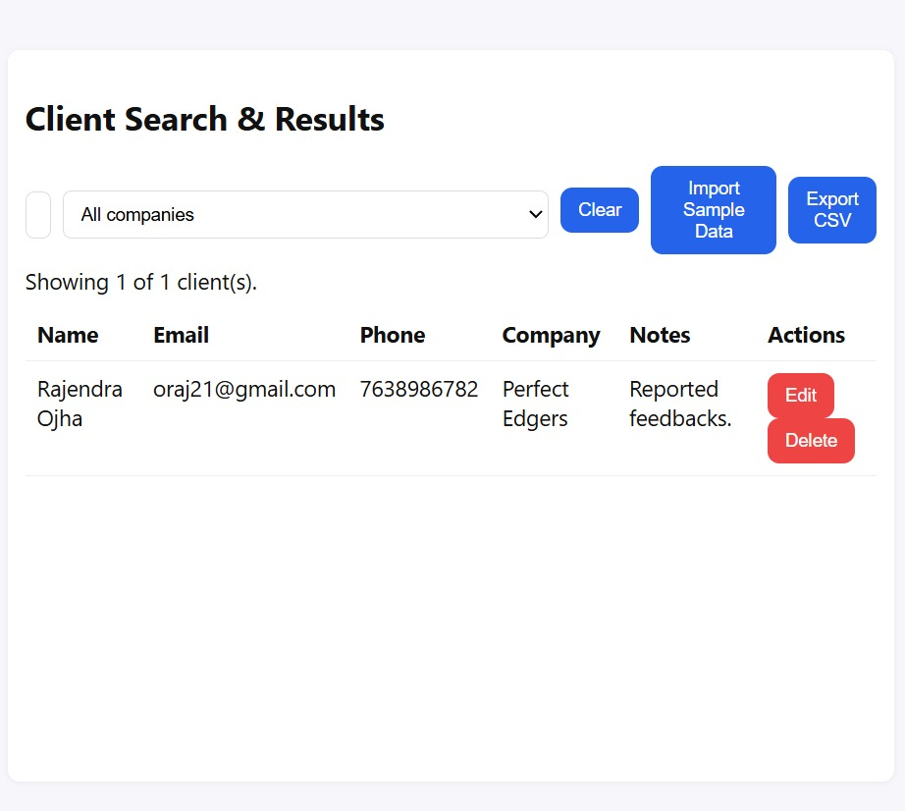
Output description
Client Side
Client Entry Form/ Owner side

Slide 9
Results & Performance
Response Time < 1 Second Even With 100 Records.
Accurate CRUD Operations Verified.
User Feedback Positive For Simplicity And Reliability.
Graph: Number Of Clients Vs Response Time.

Slide 10
Conclusion
A Complete CRM Prototype Built Using Python.
Demonstrates OOP, File Handling, And SDLC Concepts.
Reliable, Efficient, And Educational.
Serves As A Base For Future Scalable CRM Solutions.

Slide 11
Thank You

